Slide 1

RCB IPL Strategy – SQL Analytics
Data-Driven Player Selection & Mega Auction Strategy
by – Ashutosh Giri

Slide 2

PROBLEM STATEMENT
RCB is looking to identify top-performing and reliable players for the 2017 mega auction while considering on-field performance and value for money.
Identify high-performing and consistent players
Evaluate batting, bowling and player versatility
Analyse team and venue performance
Identify factors affecting match outcomes
Develop data-driven auction strategies

Slide 3
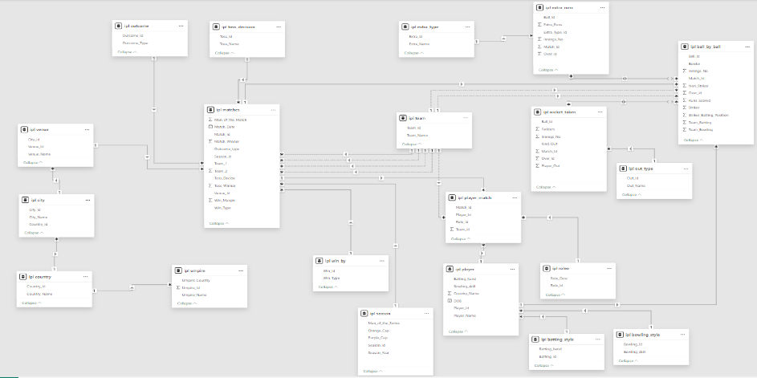
DATABASE SCHEMA

Slide 4
DATA OVERVIEW
Matches: 255 records covering toss results, winners, venues, and seasons.
Season: 9 seasons (2008–2016) including Orange/Purple Cap data.
Venue: 35 grounds across India and international locations.
Outcome: Categories for match results (Win, Tie, No Result).
Win_By: Methods of victory (By Runs or By Wickets).
Ball_by_Ball: 37,284+ granular records of every delivery, run, and player involved.
Wicket_Taken: Detailed dismissal data (Who, How, and which ball).
Extra_Runs: Tracking of all wides, no-balls, and byes per delivery.
Extra_Type: Classification of extras (Leg-bye, Wide, etc.).
Out_Type: Categorization of dismissals (Caught, Bowled, LBW, etc.).
Player: Biographic data for 469 players, including DOB and skills.
Team: 13 franchises, including RCB (Team_Id = 2).
Player_Match: Mapping of which player represented which team in specific matches.
Rolee: Definitive player roles (Batsman, Bowler, All-rounder).
Batting_Style / Bowling_Style: Specific technical descriptions (Right-hand, Left-arm fast, etc.).
Toss_Decision: Strategic data on Bat vs. Field choices.
Umpire: Names and nationalities of match officials.

Slide 5
RCB SEASON-WISE PERFORMANCE
2013: RCB won 9 matches and lost 7, showing a positive season record.
2014: RCB's performance dropped significantly, with only 5 wins against 9 losses.
2015: RCB improved to 8 wins and 6 losses, showing recovery from the previous season.
2016: RCB again recorded 9 wins and 7 losses, maintaining a positive win-loss record.

Slide 6
MOST CONSISTENT PLAYERS ACROSS IPL SEASONS
DA Warner has the highest average runs at approximately 518, making him the strongest consistent performer in the chart.
V Kohli follows closely with approximately 506 average runs.
AB de Villiers ranks third with approximately 441 average runs.
RG Sharma and RV Uthappa also show strong consistency with average runs above 400.
The chart indicates that these players maintained a strong batting contribution across seasons.

Slide 7
TOP PERFORMING PLAYERS – BEST FIT FOR RCB
DA Warner leads the chart with 2,077 runs, making him the highest run-scorer.
V Kohli follows closely with 2,031 runs, showing strong batting value.
AB de Villiers ranks third with 1,771 runs.
RG Sharma and RV Uthappa also contribute strongly with 1,652 and 1,610 runs respectively.
These players stand out as strong candidates based on their overall run-scoring performance.

Slide 8
BATTING AND BOWLING VERSATILITY
The chart shows a positive contribution in both total runs and total wickets across the selected players.
Players with higher wicket counts do not necessarily have the highest run totals, showing that batting and bowling strengths vary across players.
The highest run contribution is around 1,000 runs, while the highest wicket contribution is around 60 wickets.
The chart demonstrates the value of having players who can contribute in both batting and bowling, providing greater team flexibility.

Slide 9
IMPACT OF PLAYER PRESENCE ON RCB WIN PERFORMANCE
The win percentage is higher with every player shown compared with the win percentage without them.
The largest visible difference is for KL Rahul, where the win percentage is approximately 63% with the player vs 44% without.
STR Binny, RP Singh and Sachin Baby also show a substantial positive difference of roughly 16–18 percentage points.
Even the smallest gap in the chart, for SR Watson, remains positive at around 8 percentage points.
This indicates a positive association between the presence of these players and RCB's win percentage.

Slide 10
RCB HOME VS AWAY PERFORMANCE
RCB's home win percentage is approximately 55%.
RCB's away win percentage is approximately 45%.
Home performance is therefore around 10 percentage points better than away performance.
This indicates a clear home-ground advantage for RCB.

Slide 11
RCB MEGA AUCTION – PLAYER PERFORMANCE ANALYSIS
V Kohli has the highest total runs in the chart, exceeding 2,000 runs.
AB de Villiers is the next major run contributor, with around 1,770 runs.
CH Gayle and KD Karthik also show strong batting contributions.
SR Watson stands out as an important contributor with around 1,000 runs, while also offering all-round value from the broader analysis.
The chart shows a clear difference between the highest-performing players and the lower run contributors.

Slide 12
HIGH-SCORING MATCHES AND RCB STRATEGY
All 15 matches shown recorded approximately 350+ total runs, indicating consistently high-scoring encounters.
The highest-scoring match reached approximately 422 runs.
Several matches crossed 370–400 runs, showing strong scoring intensity.
Such high-scoring matches highlight the importance of strong batting performance and effective run containment.

Slide 13
RCB SEASON-WISE PERFORMANCE ANALYSIS
2013: RCB won 9 matches and lost 7, showing a positive season record.
2014: Performance dropped significantly, with only 5 wins against 9 losses.
2015: Performance improved to 8 wins and 6 losses.
2016: RCB again recorded 9 wins and 7 losses, showing recovery from 2014.
The chart shows inconsistency across seasons, with 2014 being the weakest performance.

Slide 14
VENUE-SPECIFIC PLAYER PERFORMANCE –
M CHINNASWAMY STADIUM
V Kohli has the highest run contribution at this venue, with approximately 1,000 runs.
AB de Villiers follows with around 940 runs.
CH Gayle also shows a strong venue-specific performance with approximately 840 runs.
The remaining players have considerably lower run totals, mostly below 300 runs.
The chart shows that player performance can vary significantly based on the venue and playing conditions.

Slide 15
IMPACT OF BOWLING STYLE ON WICKET-TAKING
Right-arm medium bowling has the highest total wickets in the chart, with approximately 500 wickets.
Right-arm fast-medium ranks second with around 310 wickets.
Right-arm medium-fast and right-arm offbreak also contribute significantly, with roughly 250 and 230 wickets respectively.
Several other bowling styles contribute fewer wickets, with the lowest categories recording well below 100 wickets.
The chart indicates that bowling style has a noticeable relationship with wicket-taking output.

Slide 16
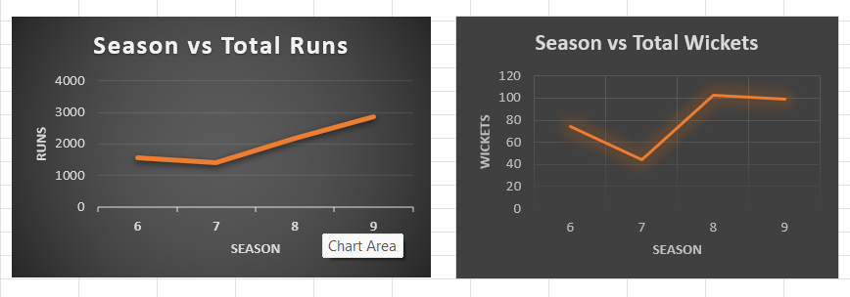
RCB SEASON-WISE PERFORMANCE: RUNS VS WICKETS
From Season 6 to 7, both total runs and wickets declined, indicating a weaker overall performance.
From Season 7 to 8, both runs and wickets increased sharply, showing a strong improvement.
From Season 8 to 9, total runs continued to increase, while wickets slightly decreased.
Overall, Season 8 and Season 9 show a much stronger performance compared with Season 7.

Slide 17
IMPACT OF TOSS DECISION ACROSS VENUES
The chart shows that the impact of the toss decision varies across venues.
At several venues, fielding first is associated with a higher win percentage.
At some venues, batting first shows a stronger result, reaching close to 100% win percentage.
This indicates that there is no single toss strategy that works equally well at every venue.

Slide 18
CONCLUSION
RCB's performance has been inconsistent across seasons, highlighting the need for a more reliable and stable squad.
Consistent performers should be prioritized over players who show strong performance only in a single season.
Top-performing batsmen are crucial for maintaining RCB's scoring strength, especially in high-scoring matches.
Versatile players who contribute with both bat and ball can provide greater flexibility and balance to the squad.
Venue-specific performance should influence player selection, as some players perform significantly better under particular conditions.
RCB should maximize its home-ground advantage while improving its performance in away matches.
Bowling strength needs equal attention, as increasing batting performance alone may not be sufficient to consistently win matches.
Mega-auction investments should be data-driven, combining performance, consistency, versatility, venue suitability and overall team impact to achieve better value for money.

Slide 19
RECOMMENDATIONS
Prioritize consistent performers with strong records across multiple seasons rather than relying on one-season form.
Retain a strong batting core by investing in proven high-run contributors who can handle high-scoring matches.
Invest in quality all-rounders who can contribute with both bat and ball and provide greater squad flexibility.
Strengthen the bowling unit, particularly with reliable wicket-taking options to complement RCB's strong batting.
Use venue-specific data when selecting players and the playing XI to exploit individual strengths under different conditions.
Adopt a venue-based toss strategy, choosing to bat or field according to historical performance at each ground.
Maximize home-ground advantage while developing a stronger strategy and squad for away matches.
Follow a data-driven auction strategy, balancing player performance, consistency, versatility, venue suitability and overall value for money before making major investments.

Slide 20
THANK YOU

